Slide 1
Data Structures and Algorithm
Tree

Slide 2

Introduction
Organizational Chart

Slide 3
Introduction
Representation of algebraic expression
Z=(J - K) / ((L * M) + N)
/
-
+
J
K
٭
N
L
M

Slide 4
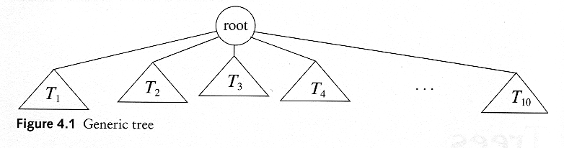
Tree Definition
A tree is a collection of nodes
  The collection can be empty
  If not empty, a tree consists of a distinguished node R (the root), and zero or more nonempty subtrees T₁, T₂, ...., T_{k}, each of whose roots are connected by a directed edge from R.

Slide 5
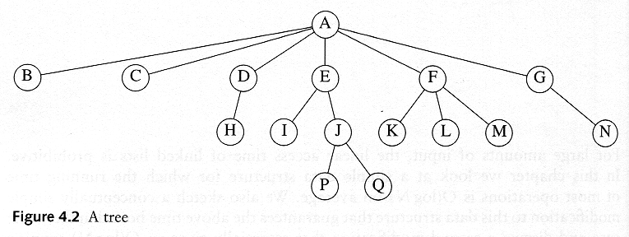

Slide 6
Tree Terminologies
Root
  It is the mother node of a tree structure. This tree does not have parent. It is the first node in hierarchical arrangement.
Node
  The node of a tree stores the data and its role is the same as in the linked list. Nodes are connected by the means of links with other nodes.
Parent
  It is the immediate predecessor of a node. In the figure A is the parent of B and C.
A
B
C

Slide 7
Tree Terminologies
A
B
C
Child
  When a predecessor of a node is parent then all successor nodes are called child nodes. In the figure B and C are the child nodes of A
Link / Edge
  An edge connects the two nodes. The line drawn from one node to other node is called edge / link. Link is nothing but a pointer to node in a tree structure.
Leaf
  This node is located at the end of the tree. It does not have any child hence it is called leaf node.

Slide 8

Tree Terminologies
Level
  Level is the rank of tree hierarchy. The whole tree structured is leveled. The level of the root node is always at 0. the immediate children of root are at level 1 and their children are at level 2 and so no.
Height
  The highest number of nodes that is possible in a way starting from the first node (ROOT) to a leaf node is called the height of tree. The formula for finding the height of a tree , where h is the height and I is the max level of the tree
Root node
Interior nodes
Height
Leaf nodes

Slide 9
Tree Terminologies
Sibling
  The child node of same parent are called sibling. They are also called brother nodes.
Degree of a Node
  The maximum number of children that exists for a node is called as degree of a node.
Terminal Node
  The node with degree zero is called terminal node or leaf.
Path length.
  Is the number of successive edges from source node to destination node.
Ancestor and descendant
  Proper ancestor and proper descendant

Slide 10
Tree Terminologies
Depth
  Depth of a binary tree is the maximum level of any leaf of a tree.
Forest
  It is a group of disjoint trees. If we remove a root node from a tree then it becomes the forest. In the following example, if we remove a root A then two disjoint sub-trees will be observed. They are left sub-tree B and right sub-tree C.
A
B
C
D
E
F

Slide 11
Binary Trees
The simplest form of tree is a binary tree. A binary tree consists of
  a node (called the root node) and
  left and right sub-trees.
  Both the sub-trees are themselves binary trees
We now have a recursively defined data structure.
Also, a tree is binary if each node of it has a maximum of two branches i.e. a node of a binary tree can have maximum two children.

Slide 12
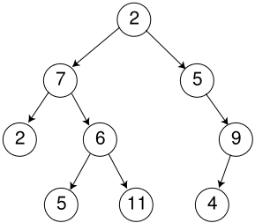
A Binary Tree

Slide 13
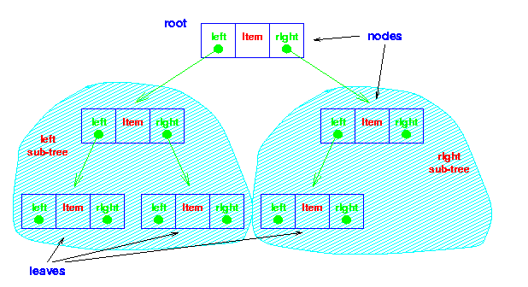
Binary Tree

Slide 14
Notation
node
root
  left subtree
  right subtree
A
B
C
D
E
F
G
H
I
It consists of a root and two subtrees

Slide 15
Notation
A
B
C
D
E
F
G
H
I
edge –
there is an edge from the root to its children

Slide 16
Notation
A
children
B
C
D
E
F
G
H
I

Slide 17
Notation
A
children
B
C
Who are node C’s children?
D
E
F
G
H
I
Who are node A’s children?

Slide 18
Notation
A
descendants
B
C
Who are node C’s descendants?
D
E
F
G
H
I
Who are node A’s descendants?

Slide 19
Notation
A
parents
B
C
Who is node E’s parent?
D
E
F
G
H
I
Who is node H’s parent?

Slide 20
Notation
A
ancestors
B
C
Who are node D’s ancestors?
D
E
F
G
H
I
Who are node H’s ancestors?

Slide 21
Notation
from J to A
A
B
C
path –
If n1, n2,…nk is a sequence of nodes such that ni is the parent of ni+1, then that sequence is a path.
D
E
F
G
H
I
J
The length of the path is k-1.

Slide 22
Notation
A
B
C
2
D
E
F
depth –
the length of the path from the root of the tree to the node
G
H
I

Slide 23
Notation
0
A
1
B
C
2
D
E
F
3
G
H
I
level –
all nodes of depth d are at level d in the tree

Slide 24

Notation
A
B
C
D
E
F
leaf node –
any node that has two
empty children
G
H
I

Slide 25
Notation
A
B
C
D
E
F
internal node –
any node that has at least one
non-emptyChild
Or
An internal node of a tree is any node which has degree greater than one.
G
H
I

Slide 26
Binary Trees
Some Binary Trees
One node
Two nodes
Three nodes

Slide 27
Strictly Binary Tree
When every non-leaf node in binary tree is filled with left and right sub-trees, the tree is called strictly binary tree.
A
B
C
D
E
F
G

Slide 28
Complete Binary Tree
A Complete binary tree is:
A tree in which each level of the tree is completely filled.
Except, possibly the bottom level.
A
B
C
D
E
F
G
H
I
J

Slide 29
Dynamic Implementation of Binary Tree
Linked Implementation

Slide 30
Structure Definition of Binary Tree Using Dynamic Implementation
The fundamental component of binary tree is node.
In binary tree node should consist of three things.
  Data
    Stores given values
  Left child
    is a link field and hold the address of its left node
  Right child.
    Is a link field and holds the address of its right node.
struct node
{
int data
node *left_child;
node *right_child;
};

Slide 31
Operations on Binary Tree
Create
  Create an empty binary tree
Empty
  Return true when binary tree is empty else return false.
Lchild
  A pointer is returned to left child of a node, when a node is without left child, NULL pointer is returned.
Rchild
  A pointer is returned to right child of a node, when a node is without left child, NULL pointer is returned.
Father/Parent
  A pointer to father of a node is returned.

Slide 32
Operations on Binary Tree
Sibling
  A pointer to brother of the node is returned or else NULL pointer is returned.
Tree Traversal
  Inorder Traversal
  Preorder Traversal
  Postorder Traversal
Insert
  To insert a node
Deletion
  To delete a node
Search
  To search a given node
Copy
  Copy one tree into another.

Slide 33
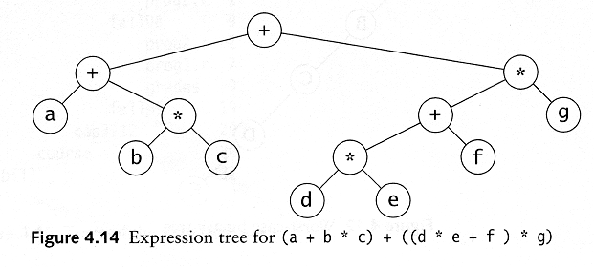
Example: Expression Trees
Leaves are operands (constants or variables)
The other nodes (internal nodes) contain operators

Slide 34
Traversal of a Binary Tree
Used to display/access the data in a tree in a certain order.
In traversing always right sub-tree is traversed after left sub-tree.
Three methods of traversing
  Preorder Traversing
    Root – Left –Right
  Inorder Traversing
    Left – Root – Right
  Postorder Traversing
    Left – Right - Root

Slide 35
Preorder Traversal
Preorder traversal
  Node – Left – Right
  Prefix expression
    ++a*bc*+*defg

Slide 36
Inorder Traversal
Inorder traversal
  left, node, right.
  infix expression
    a+b*c+d*e+f*g

Slide 37
Postorder Traversal
Postorder Traversal
  left, right, node
  postfix expression
    abc*+de*f+g*+

Slide 38
Traversal Exercise
Traverse the following tree.
14
15
4
3
18
9
14
20
7
9
16
Pre-order Traversal?
Post-order Traversal?
In-order Traversal?
5
17
4
5

Slide 39
Binary Search Tree

Slide 40
Binary Search Tree
Stores keys in the nodes in a way so that searching, insertion and deletion can be done efficiently.
Binary search tree is either empty or each node N of tree satisfies the following property
  The Key value in the left child is not more than the value of root
  The key value in the right child is more than or identical to the value of root
  All the sub-trees, i.e. left and right sub-trees follow the two rules mention above.

Slide 41

Examples
A binary search tree
Not a binary search tree

Slide 42

Example 2
Two binary search trees representing the same Data set:

Slide 43
Example
Input list of numbers:
14 15 4 9 7 18 3 5 16 4 20 17 9 14 5
14

Slide 44
Example
Input list of numbers:
14 15 4 9 7 18 3 5 16 4 20 17 9 14 5
14
15

Slide 45
Example
Input list of numbers:
14 15 4 9 7 18 3 5 16 4 20 17 9 14 5
14
4
15

Slide 46
Example
Input list of numbers:
14 15 4 9 7 18 3 5 16 4 20 17 9 14 5
14
4
15
9

Slide 47
Example
Input list of numbers:
14 15 4 9 7 18 3 5 16 4 20 17 9 14 5
14
4
15
9
7

Slide 48
Example
Input list of numbers:
14 15 4 9 7 18 3 5 16 4 20 17 9 14 5
14
4
15
9
18
7

Slide 49
Example
Input list of numbers:
14 15 4 9 7 18 3 5 16 4 20 17 9 14 5
14
4
15
3
9
18
7

Slide 50
Example
Input list of numbers:
14 15 4 9 7 18 3 5 16 4 20 17 9 14 5
14
4
15
3
9
18
7
5

Slide 51
Example
Input list of numbers:
14 15 4 9 7 18 3 5 16 4 20 17 9 14 5
14
4
15
3
9
18
7
16
5

Slide 52
Example
Input list of numbers:
14 15 4 9 7 18 3 5 16 4 20 17 9 14 5
14
4
15
3
9
18
7
16
5
4

Slide 53
Example
Input list of numbers:
14 15 4 9 7 18 3 5 16 4 20 17 9 14 5
14
4
15
3
9
18
7
16
20
5
4

Slide 54
Example
Input list of numbers:
14 15 4 9 7 18 3 5 16 4 20 17 9 14 5
14
4
15
3
9
18
7
16
20
17
5
4

Slide 55
Example
Input list of numbers:
14 15 4 9 7 18 3 5 16 4 20 17 9 14 5
14
4
15
3
9
18
7
9
16
20
17
5
4

Slide 56
Example
Input list of numbers:
14 15 4 9 7 18 3 5 16 4 20 17 9 14 5
14
4
15
3
9
14
18
7
9
16
20
17
5
4

Slide 57
Example
Input list of numbers:
14 15 4 9 7 18 3 5 16 4 20 17 9 14 5
14
4
15
3
9
14
18
7
9
16
20
17
5
“Binary Search Tree” of a given data set
4
5

Slide 58
Binary Tree Implementation
Class BinaryTree{
private:
struct node{
int data;
node* LTree;
node* RTree;
};
public:
node* root;
BinaryTree( ){ root = NULL; }
node* Insert(node* , int);
void Search(node* , int);
void InorderTraversal(node*);
void PreorderTraversal(node*);
void PostorderTraversal(node*);
};

Slide 59
Inorder Traversal Function
void BinaryTree::InorderTraversal(node* temp)
{
if(temp!=NULL)
{
InorderTraversal(temp->LTree);
cout<< temp->data;
InorderTraversal(temp->RTree);
}
}

Slide 60
Postorder Traversal Function
void BinaryTree::PostorderTraversal(node* temp)
{
if(temp!=NULL)
{
PostorderTraversal(temp->LTree);
PostorderTraversal(temp->RTree);
cout<< temp->data;
}
}

Slide 61
Preorder Traversal Function
void BinaryTree::PreorderTraversal(node* temp)
{
if(temp!=NULL)
{
cout<<temp->data;
PreorderTraversal(temp->LTree);
PreorderTraversal(temp->RTree);
}
}

Slide 62
Searching in Binary Search Tree
Three steps of searching
  The item which is to be searched is compared with the root node. If the item is equal to the root, then we are done.
  If its less than the root node then we search in the left sub-tree.
  If its more than the root node then we search in the right sub-tree.
The above process will continue till the item is found or you reached end of the tree.

Slide 63
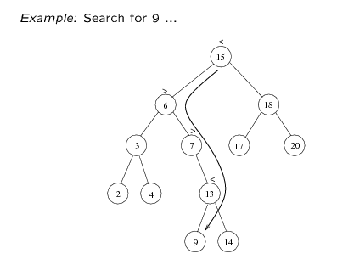
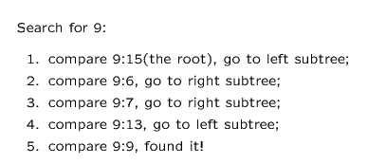

Slide 64
Search Function
void BinaryTree::Search(node* temp, int num)
{
if(temp==NULL)
cout<<“Number not found";
else if(temp->data == num)
cout<<"Number found";
else if(temp->data > num)
Search(temp->LTree, num);
else if(temp->data < num)
Search(temp->RTree, num);
}

Slide 65
Insertion in BST
Three steps of insertion
  If the root of the tree is NULL then insert the first node and root points to that node.
  If the inserted number is lesser than the root node then insert the node in the left sub-tree.
  If the inserted number is greater than the root node then insert the node in the right sub-tree.

Slide 66
Insertion Function
node* BinaryTree::Insert(node* temp, int num)
{
if ( temp == NULL )
{
temp = new node;
temp->data= num;
temp->LTree= NULL;
temp->RTree=NULL;
}
else if(num < temp->data)
temp->LTree = Insert(temp->LTree, num);
else if( num >= temp->data)
temp->RTree = Insert(temp->RTree,num);
return temp;
}

Slide 67
Deletion in BST
When we delete a node, we need to consider how we take care of the children of the deleted node.
  This has to be done such that the property of the search tree is maintained.

Slide 68
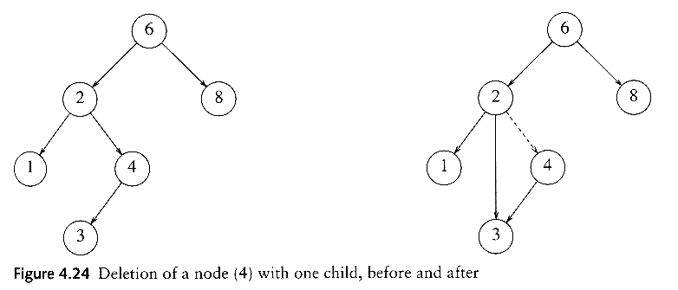
Deletion in BST
Three cases:
(1) The node is a leaf
  Delete it immediately
(2) The node has one child
  Adjust a pointer from the parent to bypass that node

Slide 69
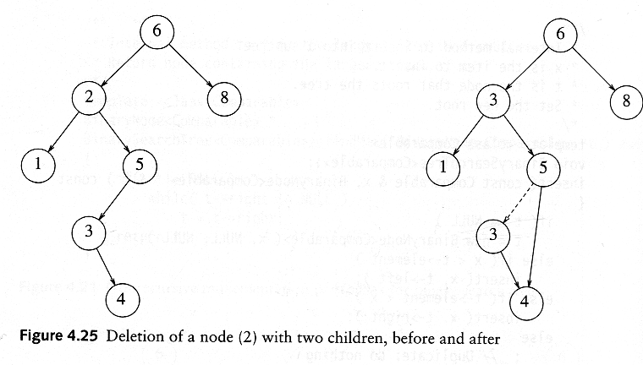
Deletion in BST
(3) The node has 2 children
  Replace the key of that node with the minimum element at the right subtree
  Delete the minimum element
    Has either no child or only right child because if it has a left child, that left child would be smaller and would have been chosen. So invoke case 1 or 2.

Slide 70
Deletion Code
void BTree::DeleteNode(node* temp, int num)
{ if (temp==NULL)
cout<<"Number not Found";
else if((temp->data == num))
{ node *parent, *min ;
int number;
// if number is found at a leaf node
if((temp->LTree == NULL) && (temp->RTree == NULL))
{
parent=GetParent(root, temp->data, root); //will return parent node
if(parent->LTree == temp)
parent->LTree = NULL;
else if (parent->RTree == temp)
parent->RTree = NULL;
delete temp;
}

Slide 71
// if node to be deleted has one child
else if(((temp->LTree == NULL) && (temp->RTree != NULL)) || ((temp->LTree != NULL) && (temp->RTree == NULL)))
{
parent = GetParent(root, temp->data, root); //will return parent node
if(temp->LTree != NULL){
if(parent->LTree == temp)
parent->LTree = temp->LTree;
else if (parent->RTree == temp)
parent->RTree = temp->LTree;
}
else if(temp->RTree != NULL){
if(parent->LTree == temp)
parent->LTree = temp->RTree;
else if (parent->RTree == temp)
parent->RTree = temp->RTree;
}
delete temp;
}

Slide 72
//if node to be deleted has two children
else if((temp->LTree != NULL) && (temp->RTree != NULL))
{
min = FindMin(temp->RTree); //will return the min. no. found in RTree
number = min->data;
DeleteNode(temp->RTree, min->data); //calling to itself recursively
temp->data= number;
}
}
else if (num < temp->data)
DeleteNode(temp->LTree, num); //calling to itself recursively
else if (num > temp->data)
DeleteNode(temp->RTree, num); //calling to itself recursively
}

